Slide 1

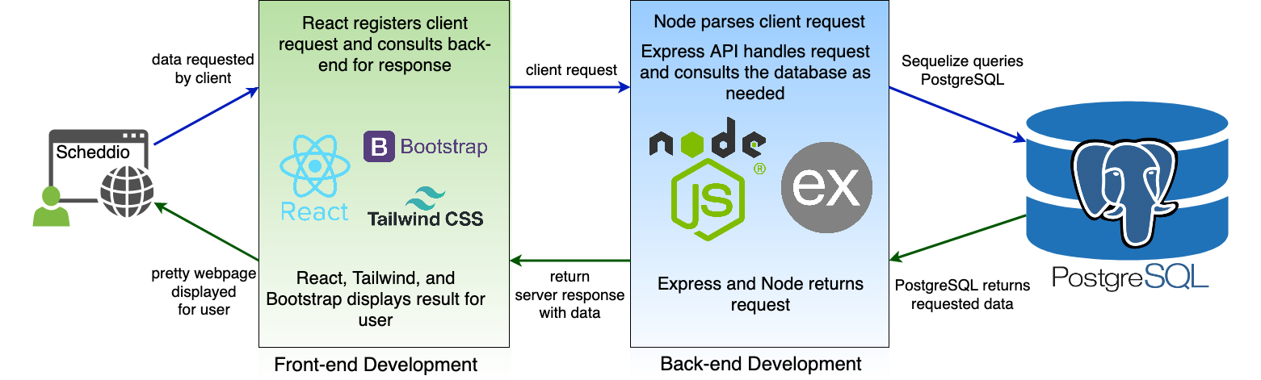
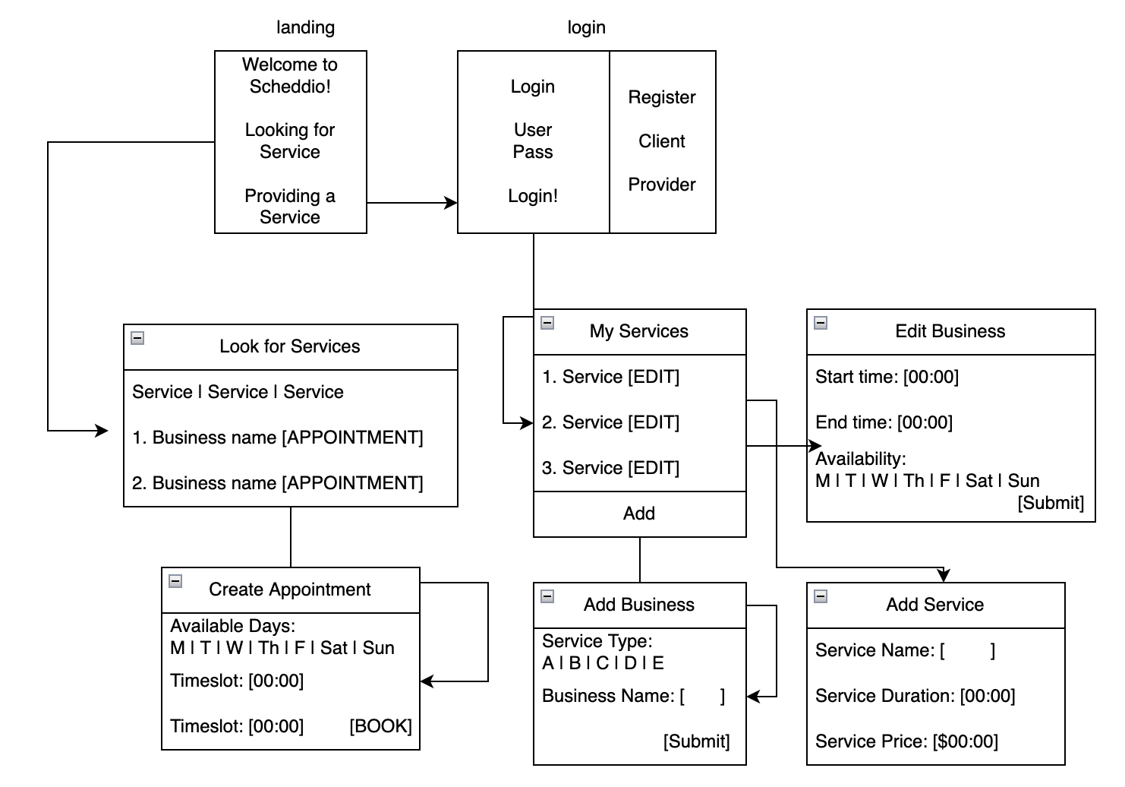
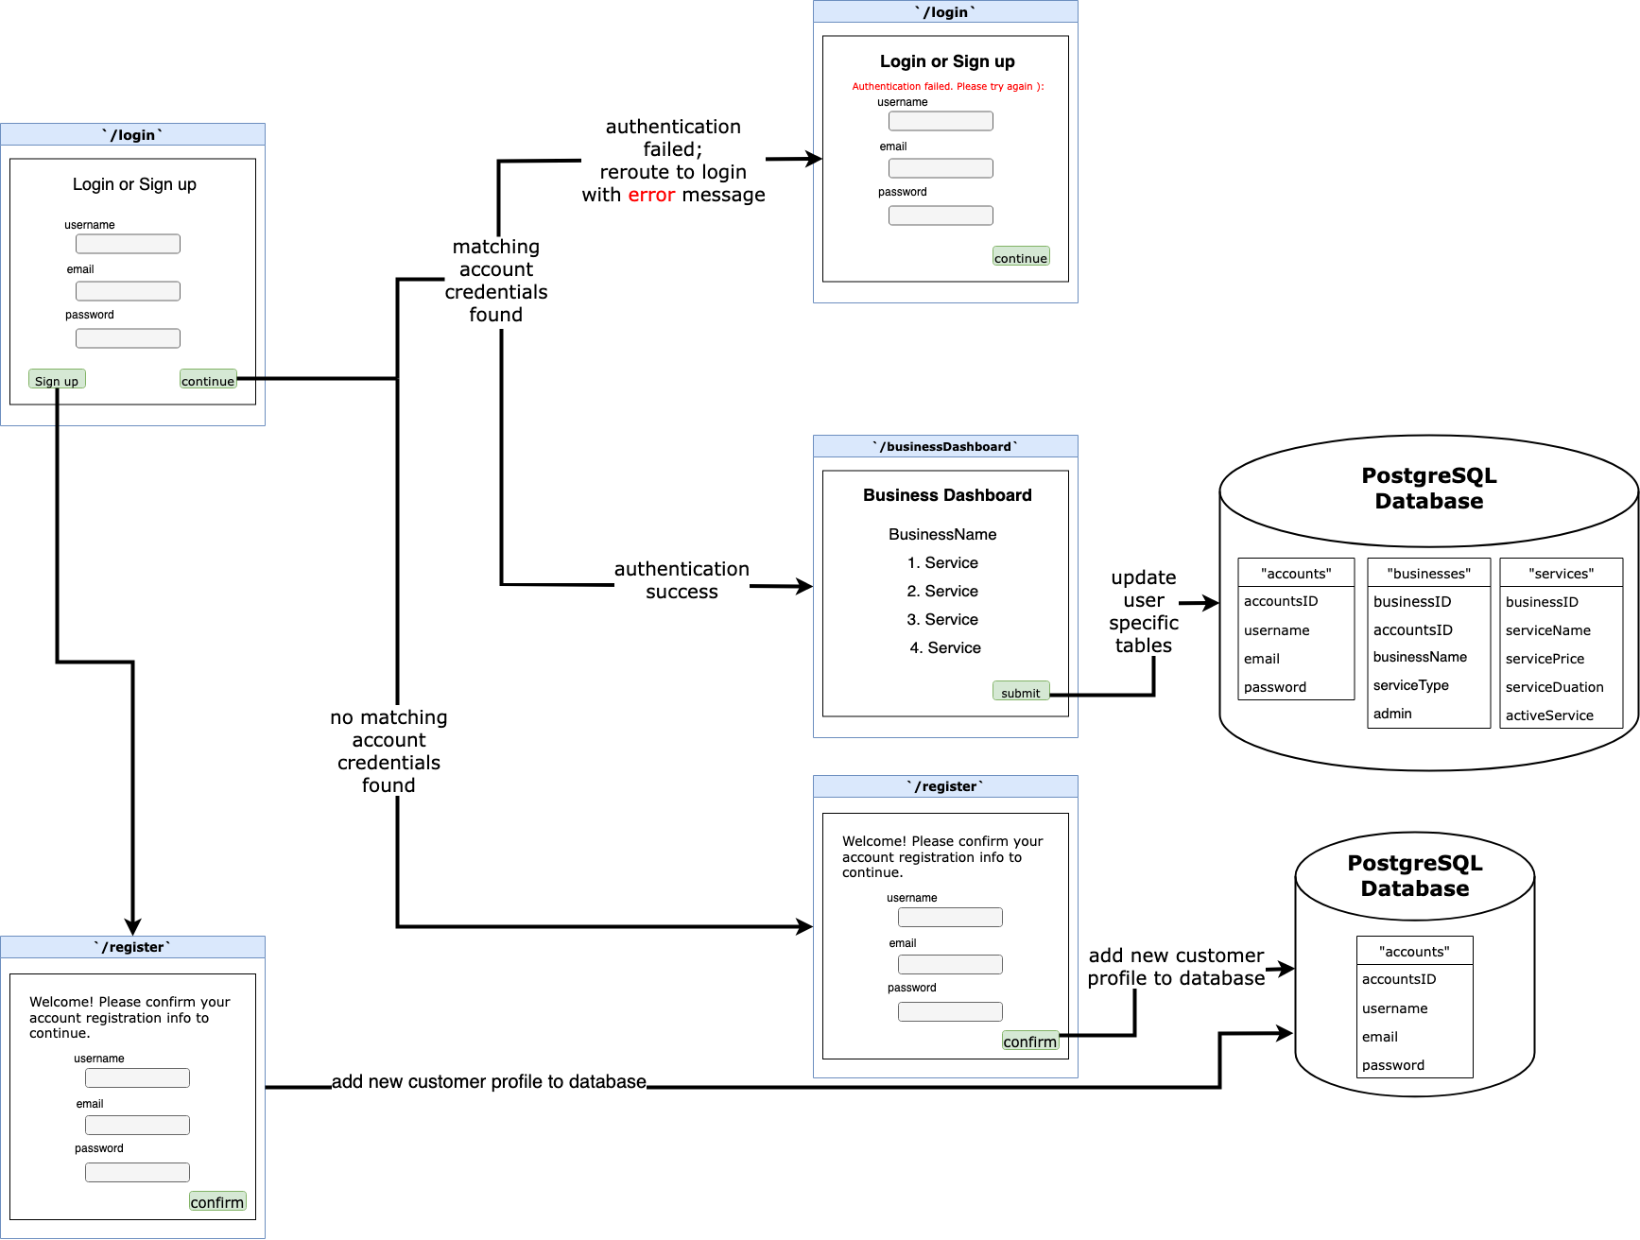







Scheddio: Business Scheduling Application
Clay Lee, Jadon Huang, Tora Tran
Sponsor and mentor: SF Dev Shop with Jose Alvarado
Project Specifications
Introduction
Design Overview
Development Difficulties
Scheddio is is a business scheduling web application created with the intention of allowing all business appointment scheduling (salons, therapy, dental visits, gyms, etc) to be performed under its interface. Business owners are able to set up their business with desired time and service availability, while customers can select time slots to schedule appointments from a variety of businesses. Scheddio aims to unite online scheduling services under a single web service based platform.
Time Constraints: as with any project, we found time to be our biggest constraint. Insufficient time affected our familiarization with more technical stack, deployment of additional functionalities, and overall workflow.
Self-learning technical stack: time constraints plays a factor in self-learning the technical stack, although its primary difficulty comes from us being new to using all the given technologies
Building and testing environment inconsistencies: throughout various stages of development, our group encountered frustrations with hardware and software version incompatabilities
Workflow updates: communication does not only involve task designation, but workflow updates so team members are able to get an idea of everyone’s rate of progression and current stage of work. While the front and back end are developed independently, its connection can only be performed with all parties working at proper pacing.
Problem Statement
Business Scheduling Flow
Attempting to schedule any type of service, whether it be a salon, therapy, or personal fitness appointment requires the navigation of far too many platforms. Users have to search for a compatible service on a search engine (Yelp, Google, etc), redirect themselves to the business website, explore its external calendar, sign up for a single use account, or make a phone call/email, all to make a single appointment. The fundamental issue is that there is no centralized service that provides appointment booking scheduling – this is the motivation behind our Business Scheduling Appointment application: Scheddio.
Current Work
Set up a successful web application to simplify the business scheduling process for both business owners and service seekers. The front end is able to send service requests to the postgres database back end.
Implemented a registration system which allows the creation of business provider and client accounts. Connected a login system to grant users unique access into their profile.
Provider accounts have add, delete, and edit functionalities for their business profiles to be able to set business availability. They can also manage services under their profile, having editing rights to service types, price, and duration
Clients are able to browse services provided by business owners according to service type. Scheduling an appointment allows them to confirm availability, before the booking is displayed on the user dashboard end,
Login/Registration Flow
Technologies Used
Future Contributions
A notification system that sends reminders to clients via SMS or email
A customer support chat system to guide users who have questions about the application
A search filter option that allows clients to search for businesses and services based on their preferences
Server hosting application to support online access
Team
Clay Lee: hlee96@dons.usfca.edu
Jadon Huang: jjhuang2@dons.usfca.edu
Tora Tran: patran@dons.usfca.edu

